Slide 1
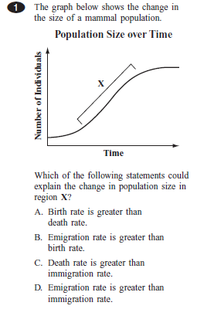
Unit 1: Intro to Science and Biology
Ms. Cardoza, Room 312
Bellwork: set up index cards, hold up correct answer when instructed to do so.
Agenda:
  Review syllabus and emergency procedures
  Lab Safety
  Textbooks
  New information (if time allows):
    Characteristics of Life

Slide 2
Tools for You
Class website- cardozabio.weebly.com
Remind.com
Google classroom- we’ll talk more about this later
DiscoveryEducation.com

Slide 3
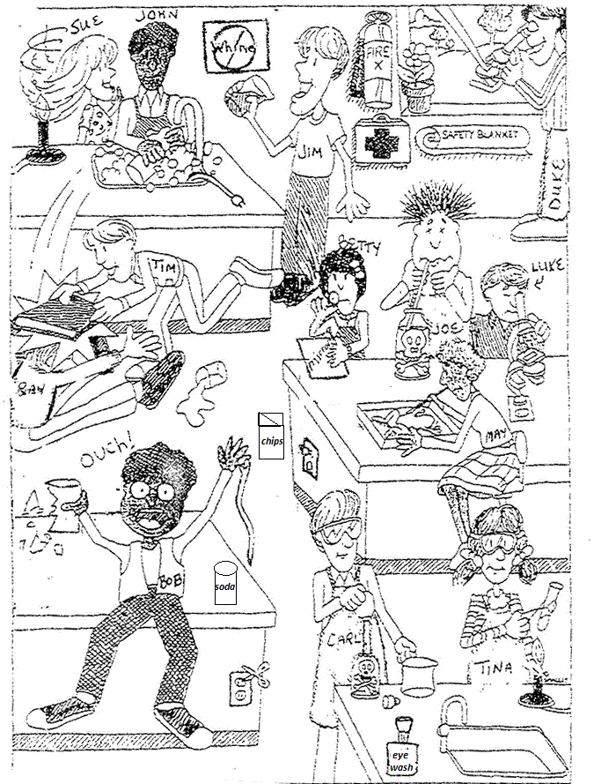

Slide 4
Agenda 9/8/15- Characteristics of Life
Bellwork- Microscope labeling; get a lap top and log in to discovery ed- all passwords have been reset to Sachems15. Change it to something you’ll remember.
Set up binders; CER: Are Plants Alive? (if not done already)
Activity: living or nonliving lab
New Information: Characteristics of Living Things
Homework: finish lab questions, if needed

Slide 5
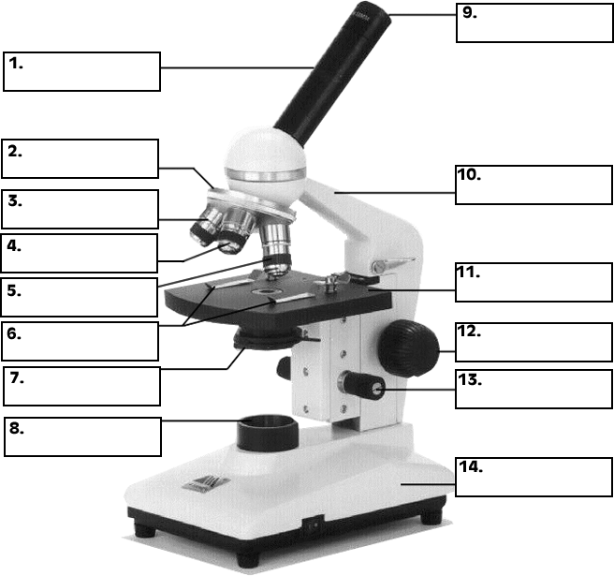
Identify the Parts
Stage
Arm
Stage clips
Base
Light source
Body tube
Ocular lens (aka eyepiece)
Scanning objective lens
Low power objective lens
High power objective lens
Fine adjustment knob
Coarse adjustment knob
Diaphragm
Revolving nosepiece

Slide 6
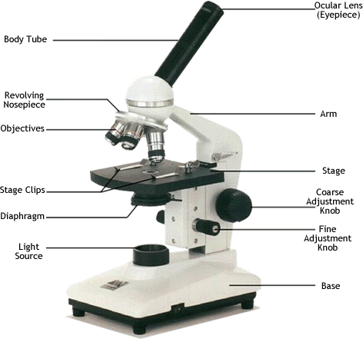
Compound Light Microscopes

Slide 7
Think, Pair, Share: What is life?
  What characteristics do you think ALL living things share? Write a list.
  On my cue, share with a partner.
  Together, pick 3- draw an example of 3 characteristics of all living things.

Slide 8
Living or Not? Activity
In pairs, write 6 characteristics you think all living things share in your lab data table (page 2)
You will have about 5 minutes at each station, and each person needs to observe at least one item and fill in the data table. You will share the information.
When everyone’s been to each station, we will discuss and take notes. Start on the questions if you finish early.
Station 1- potato, water, cut flower in water, “turtle”
Station 2- flame, ice cube, grapes
Station 3- spider plant, rock, potted plant
Station 4- pill bug or worm, dirt, onion
Station 5- microscope station: monocot cross section, drosophila; plastic bag

Slide 9

Characteristics of
Living Things
CHEDGERR
  Cells
  Homeostasis
  Energy
  DNA
  Grow and Develop
  Evolve
  Reproduce
  Respond to environment

Slide 10
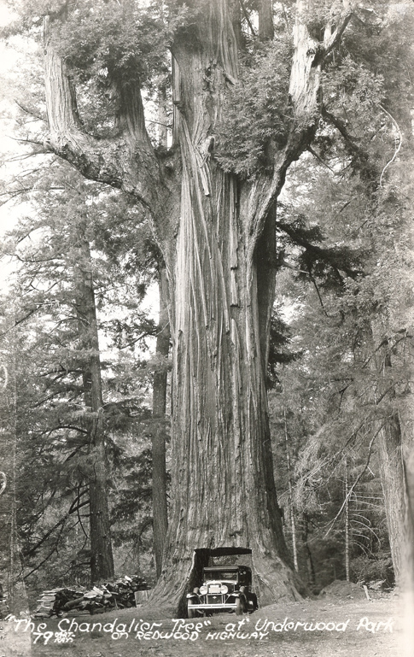
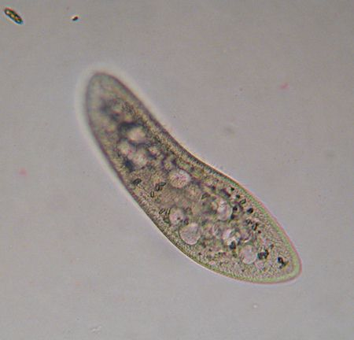
CHEDGERR- CELLS
All living things are made of cells.
Cells are the smallest unit of life.
Multicellular- multi=many
Unicellular- uni=one
Paramecium

Slide 11
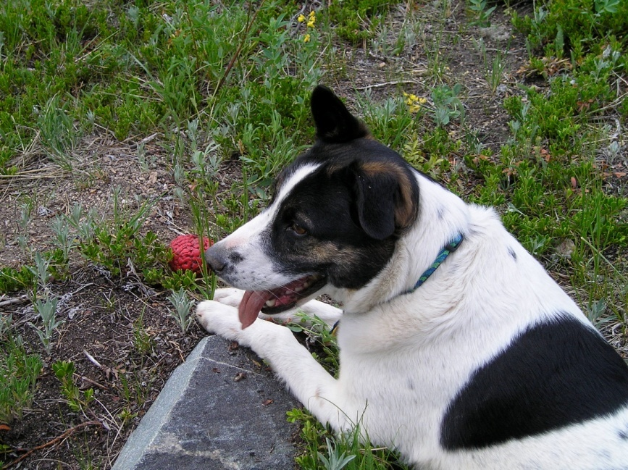
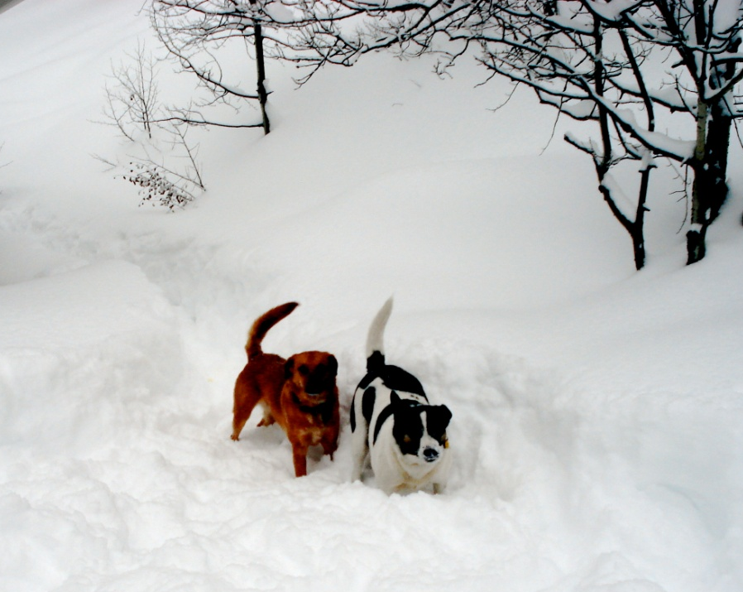
CHEDGERR- Homeostasis
Living things maintain internal equilibrium.
  Temperature (sweating, panting, fevers)
  pH

Slide 12

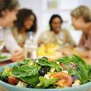
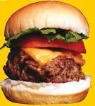
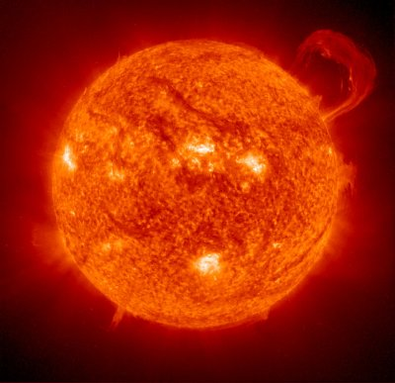
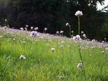
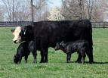
CHEDGERR- Energy
All living things require a source of energy to perform organic functions.

Slide 13
CHEDGERR- Energy
All living things require a source of energy to perform organic functions.
  Autotroph: (auto- = self, -troph = food)
    uses sunlight or chemical energy to make own food; producer
  Heterotroph: (hetero = other, different)
    gets energy from ingesting food; consumer

Slide 14
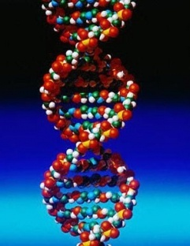
CHEDGERR- DNA
All living things share a universal genetic code, DNA.

Slide 15
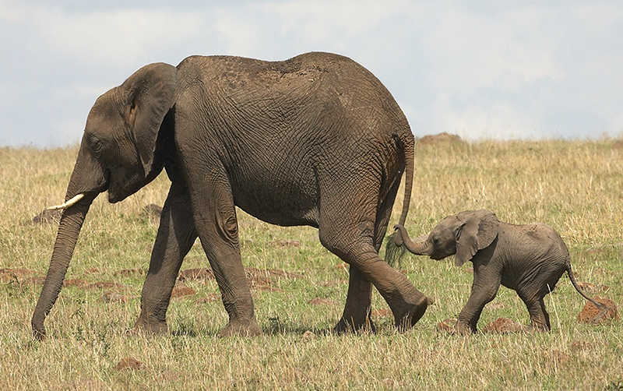
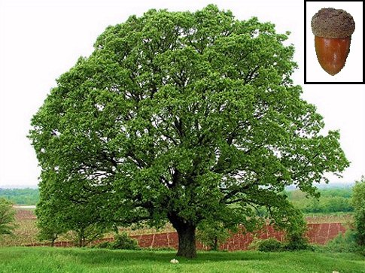
CHEDGERR-
Grow and Develop
All living things grow and develop.

Slide 16
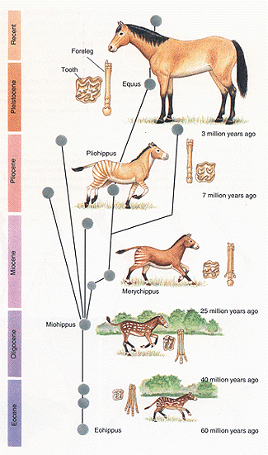

CHEDGERR-
Evolve
Groups of living things change over time.
Individual organisms DO NOT evolve- groups of organisms evolve.
We’ll talk about evolution in more depth later this semester.

Slide 17
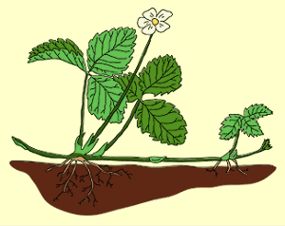
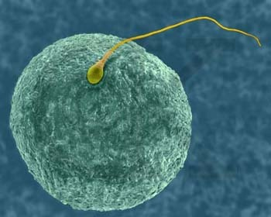
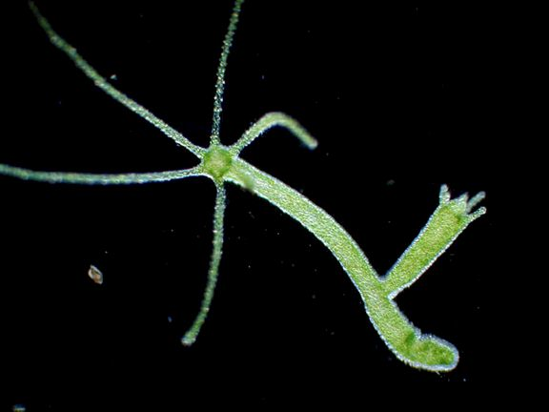
CHEDGERR- Reproduce
Living things can reproduce.
  sexual and/or asexual reproduction
Human Ovum (Egg) and Sperm
Image credit: Copyright Dennis Kunkel

Slide 18
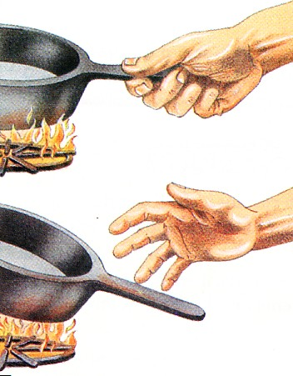
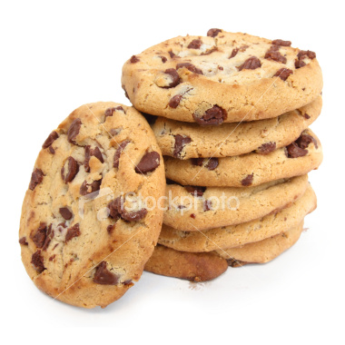
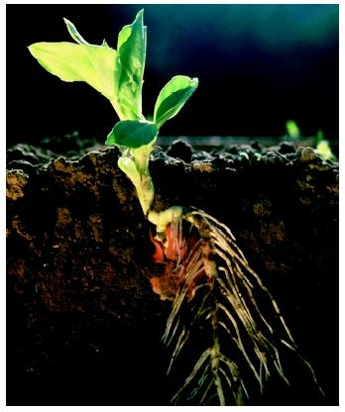
CHEDGERR- Respond
Living things respond to stimuli.

Slide 19
Characteristics of
Living Things
CHEDGERR
  Cells
  Homeostasis
  Energy
  DNA
  Grow and Develop
  Evolve
  Reproduce
  Respond to environment

Slide 20
Biology- 9/11/15
Agenda
  Bellwork- MCAS questions
  Scientific Method
  Scientific Method Practice
  Pond water sample observations

Slide 21
What Is Science?
Science is a way of knowing, based on inquiry.
Deals only with the natural world
Organized, careful, orderly data collection
Explanations for data can be tested and can be proven false
Peer review and replicable tests

Slide 22
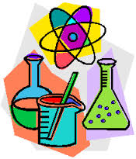
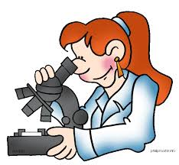

Definitions of Science
An organized way of using evidence to learn about the natural world.
The body of scientific knowledge.

Slide 23
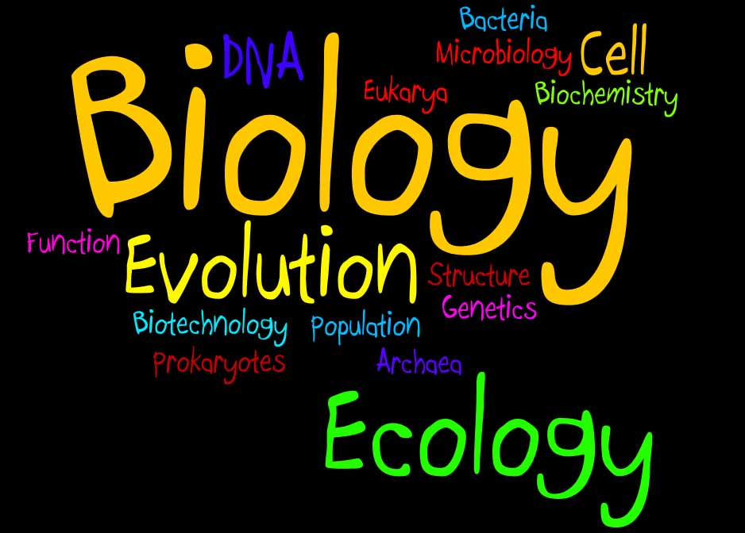
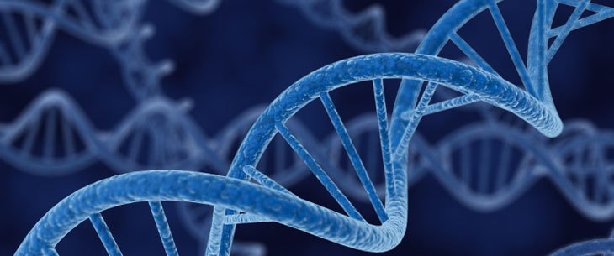
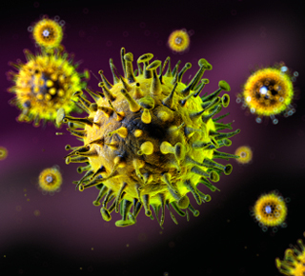
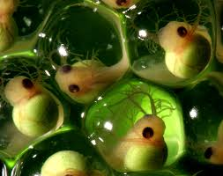
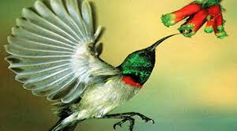
What is Biology?
Biology
  The study of life (bio = life; -ology = the study of)

Slide 24
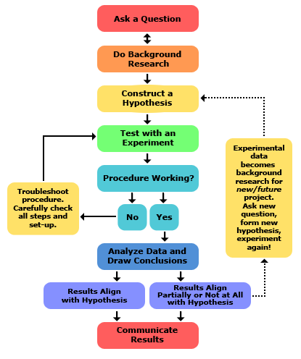
The Scientific Method
Much of research involves solving problems.
Scientists use a series of common steps to solve problems- these are called the scientific method.
You use the scientific method every day… it’s just common sense!

Slide 25
Scientific Method
Ask Question, State Problem
Form a Hypothesis
Design and Conduct and Experiment
Collect and Analyze Data
Draw Conclusions

Slide 26
Steps of the Scientific Method
State the Problem/Question
  Through observation, a problem or question is identified
  Ex. Will fertilizer make a plant grow taller?

Slide 27
Steps of the Scientific Method
Form a Hypothesis
  A hypothesis states a tentative (possible) relationship between two or more variables, and, based on that relationship, predicts what will happen in a given scenario.
  MUST BE TESTABLE!
  Based on experience, research, and previous experiments (it is not a shot in the dark!)

Slide 28
Steps of the Scientific Method
Form a Hypothesis
  If independent variable affects dependent variable, then prediction, because ____________.
  Ex. If fertilizer affects plant growth, then plants given fertilizer will grow taller than those without because fertilizer contains nutrients.

Slide 29
Steps of the Scientific Method
Design and Conduct an Experiment
  An experiment is a procedure to test a hypothesis by collecting data under CONTROLLED conditions
  Control group:
    All conditions are the same as “normal”- ex. Plants given plain water.
  Experimental group:
    All conditions same as control group EXCEPT the one being tested- ex. Plants watered with water plus fertilizer
  ONLY ONE VARIABLE should be CHANGED,or TESTED in an experiment. All other variables are called “controlled variables”

Slide 30

Independent vs. Dependent Variable
Variable: things that can be changed in an experiment.
Two main types of variables:
  Independent Variable:
    change made by the experimenter; it’s what you’re testing the effect of (ex. Using fertilizer)
  Dependent Variable:
    changes due to the independent variable; measured at the end (ex. Plant growth changes due to the addition of fertilizer)

Slide 31
Steps of the Scientific Method
Collection and Analysis of Data
  Looking at the data to see what it means.
  May use graphs, tables, spreadsheets
  Ex. Graphing the growth of the two groups of plants
Draw Conclusions
  Was the hypothesis supported by the data?
  State specific evidence to support your claim
  May lead to another hypothesis
  Ex. Based on our graph, the plants with fertilizer grew better than the plants without

Slide 32
Data
Quantitative:
  based on “quantities”- numerical, can be measured
  Length, area, volume, height, weight, age, etc.
Qualitative:
  based on “qualities”- not numerical; deals with descriptions.
  Color, texture, sound, etc.

Slide 33
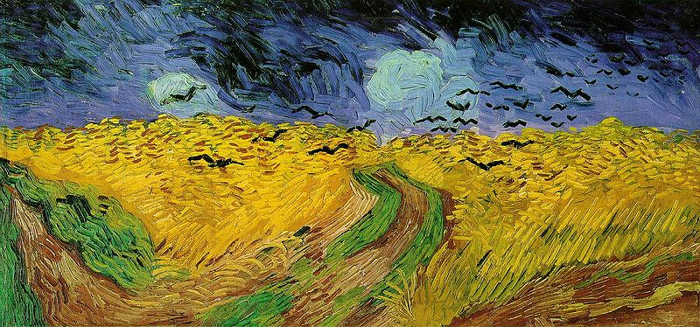
Qualitative vs. Quantitative Data
Qualitative
Quantitative
 | Qualitative data: Colors- yellow, blue, green smells old and musty texture shows brush strokes of oil paint scene of the country masterful brush strokes
 | Quantitative data: picture is 10" by 14" with frame 14" by 18" weighs 8.5 pounds surface area of painting is 140 sq. in. cost $300

Slide 34
Experimental Design-
New Prescription Drug Testing
QUESTION:
  Does the medication reduce headache pain?
INDEPENDENT variable:
  Medication
DEPENDENT variable:
  Intensity of headache pain
CONTROL GROUP:
  Group not given real medication; given placebo
Placebo effect

Slide 35
Scientific Method Practice
Pick one scientific problem from the list. With a partner, discuss how you would design an experiment around it.
Write a hypothesis (If _____ affects _____, then _________ because _______.)
Identify the following:
  Independent variable and dependent variable.
  Controlled variables (at least 3)
  What data would you need to collect?

Slide 36
Questions
Does temperature affect a plant’s growth?
Does Rogaine really improve hair growth?
Is acid rain causing a decline of frog populations?
Does the hormone estrogen increase the milk yield of dairy cows?
Does the size of a fish tank determine how large your fish will grow?
Do wounds heal faster when they are covered by Band-Aids?
Do violent video games cause children to become more aggressive?
Do tanning beds cause skin cancer?

Slide 37
Agenda 9/14- Quiz, Start Ecology
Questions?
Quiz- Intro to Science and Biology, Scientific Method, Characteristics of Life
Homework (start when done with quiz)- vocabulary HONORS: pages 408-410, 413, 417-421; CP BIO: pages 42-52
  All words in bold
  Definitions need to be no more than 7 words long, in YOUR OWN words

Slide 38
Scientific Method
Ask Question, State Problem
Form a Hypothesis
Design and Conduct and Experiment
Collect and Analyze Data
Draw Conclusions

Slide 39
Characteristics of Life
CHEDGERR

Slide 40
Quiz
Homework (start when done with quiz)- vocabulary HONORS: pages 408-410, 413, 417-421; CP BIO: pages 42-52
  All words in bold
  Definitions need to be no more than 7 words long, in YOUR OWN words

